Slide 1
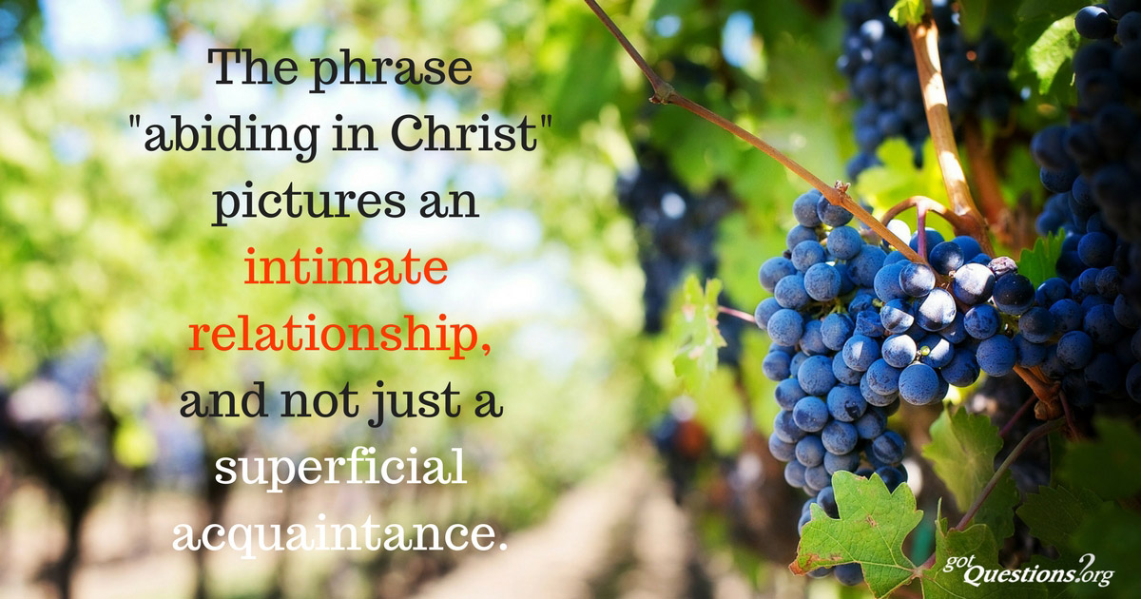
ABIDING IN CHRIST JESUS
1JOHN 2:28-29 & 3:1-10

Slide 2
Why is Apostle John warning/advising us?
QUESTIONS
What do we mean by Abiding?
How do we abide in Him?
When should we abide in Him?
Why do we need to abide in Him?
What are the resources provided to enable us to abide in Him?

Slide 3
Apostle Paul also warns /cautions us
Colossians 2:6 ‘’So then, just as you received Christ Jesus as Lord, continue to live your lives in him’’.
NB: It is a continuous relationship.
Galatians 2:20 ‘ I have been crucified with Christ and I no longer live, but Christ lives in me. The life I now live in the body, I live by faith in the Son of God, who loved me and gave himself for me’.
NB : a lasting intimacy with Christ Jesus

Slide 4
The words of the saviour.
John 15:16 ( Jesus chose us so as to bear fruit and that the fruit should last).
John 15: 4-5 .. No branch can bear fruit by itself…..apart from Jesus we can do nothing.
Why is fruit bearing important?.
Because God sold all and bought it (Matt.13:45-46)
God is glorified(John 15:8)
Because Jesus desires it

Slide 5
Answers why Apostle John warns us.
Because of the hope we have(k’dom of God)
Because in these our days deception is on the increase( Jesus warned in Matt. 24:4).
Because satan has now ‘sugar-coated’ or banded evil so that certain things looks attractive while sin is no longer considered as sin.
Because the road is slippery and challenging which makes it easier to give up.
Because the spirit of anti-christ is already in the world.
Because he does not want us to be ashamed when the Lord appears (vrs 28)

Slide 6
Resources available so as to be able to abide
The word of God-Ps 119:130
The name of Jesus-Philip2:10
The blood of Jesus-Rev.12:11
The Holy Spirit-Jn, 14:16
Fellowship with sanctified brethren-Prov. 27:17
GOD BLESS YOU FOR LISTENING AND ACTING!

