Slide 1
THE DISCIPLE’S AUTHORITY. (2TIMOTHY 3:16)
What does it mean?
Why was this given?
How did the disciple applied the inspired word?

Slide 2
Answers:
Having the right or power to make decisions and enforcing obedience.
It is refer to as the authority of God’s word.
Given to equip the believer in Christ so as to overcome challenges or dilemma in our Christian journey.(Acts 14:22).
i.e.- living a holy and righteous life as disciples
NB: Apostle Paul encouraged Timothy with the verse above (Timothy faced challenges in the city of Ephesus).

Slide 3
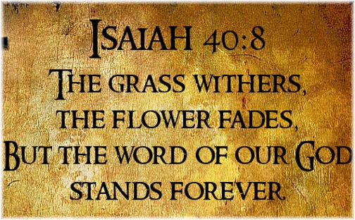
GK word ‘Theopneutos’ is translated ‘inspire’ which is use to describe God-breadth.
NB: theos (Gk)= word of God
pneuma(Gk)= power house (life , force, energy, dynamism and power).
How was this given?
God passed His power, heart beat through spirit filled men who wrote. Hence the bible is God-breadth in a written form.
Part of God in man(Gen. 2:7) dust became significant.
Example: trumpet or balloon carries your DNA.
Because God never dies so also His breadth will never die

Slide 4
Though written, it is still God’s property. Meaning the power/authority behind it remains God. Hence any disciple holding onto it is actually holding on to an authority that has no end(Matt.24:35).
Even as a secretary writes a verbal statement from a manager mouth, it then becomes manager’s authorised information to all.
* The only thing that can change man(Ezek. 36:25-27).
Surprisingly Lk. 4:1-11 reveals that , even satan recognises it as God’s breadth and authority and hence try to use it.
Jesus knows all that too well so He quoted , taught and trained His disciples to do same.(Acts.1:1-2)

Slide 5
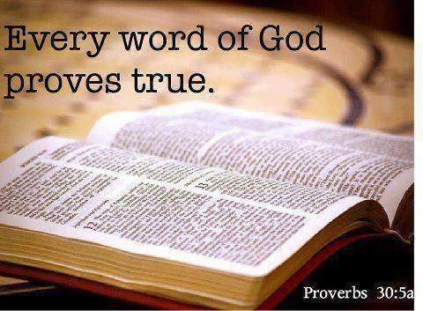
How did the disciples applied the inspired word?
Apostle Peter knows it is his right to save souls(Acts. 2:38).
He used it to exert his authority over unclean spirit and got the sick healed by his shadow(Acts.5:15)
Having this authority , Philip yielded in obedience and got the Eunuch dilemma and confusion(Acts.8:26-39).
Apostle Peter again proclaimed his authority over a long chronic illness and the man begun to walk (Acts. 3:2-6).
God bless you as you take hold of your right which also is your authority. Amen!

