Slide 1
John 1.29-50
Whole Church Values
Following Jesus
Word and Spirit
Engaging in Mission
Embracing Adventure
Growing Community
Faithful in Prayer
Notes:
We see different values being lived out.
People follow Jesus.
Disciples embrace adventure when they leave John the Baptist to follow their new master
A community comes together and begins to grow.

Slide 2
1. Who Jesus is
The Eternal Son (vs 30,34)
Notes:
Jesus was ‘before’ John the Baptist, supreme in time and rank (cf. John 1.1-28; Col. 1.15-20). He is the uncreated Son of God as well as the Son of Man (v34 cf. v51) – fully human and fully divine. The disciples have still to grasp this, as John, the writer of the gospel, makes clear. But the truth is set out clearly for us in this great chapter.

Slide 3
The Lamb of God (vs 29, 23)
Notes:
A lamb was for sacrifice, as the Jewish people well knew (see e.g. Exodus 12). Jesus was going to be the sacrifice for the sins – the wrongdoing and rebellion against God – of the whole world. Campbell Morgan contrasts Isaac’s question to Abraham in Genesis 22.7-8, ‘where is the lamb for the lamb for the burnt offering?’ with what is said in John 1. Morgan proposes that the Old Testament effectively poses the question, ‘where is the lamb?’, whilst the New Testament effectively answers, ‘here is the Lamb’. Jesus fulfils the whole sacrificial system of the OT in his once for all time sacrifice for us on the cross. He dies in our place, giving his life that we might live. Indeed he is the ‘lamb of God who takes away the sin of the world’.

Slide 4
The Way to God (v51)
Notes:
The OT background here is Genesis 28.12. In a dream, Jacob sees a ‘ladder’ (NRSV) or ‘stairway’ (NIV) linking earth and heaven, with angels ascending and descending on it. Jesus takes this imagery and uses it of himself. He is the ladder connecting heaven and earth; as he would later put it, he is not only the ‘truth’ and the ‘life’ but also the ‘way’ (John 14.6). ‘The place where people encounter God now is in the person of his Son, Jesus, and it is through him that God is now revealing his truth.’ (Colin Kruse)
Connecting up these three points, Jesus is God’s own Son, who gives his life for us on the cross, thus opening the way to God’s presence. The gospel is glorious indeed. It leads Christians to rejoice, and it challenges others to put their trust in Jesus, to respond to his call, ‘follow me’ (v43). The two instances of ‘you’ in v51 are plural. Jesus speaks not only to Nathanael but to all who will listen. His words constitute both a challenge and an invitation.

Slide 5
An invitation from Jesus…
Notes:
The invitation to follow is an invitation to hospitality.
Spend time with Jesus

Slide 6
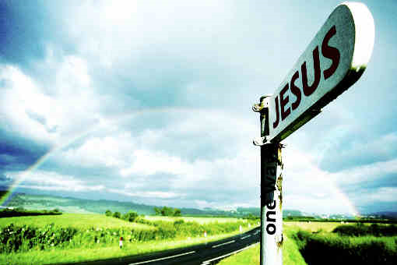
2. How the Gospel Spreads
Point to Jesus and introduce people to Jesus
God uses imperfect people to do this

Slide 9
Introduce / Point people to Jesus
Share the good news
Share our stories
Pray for people and encourage them to ‘try praying’ themselves
Invite people, e.g. to Alpha

