Slide 1
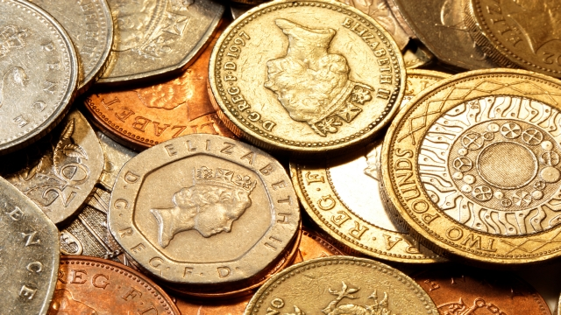
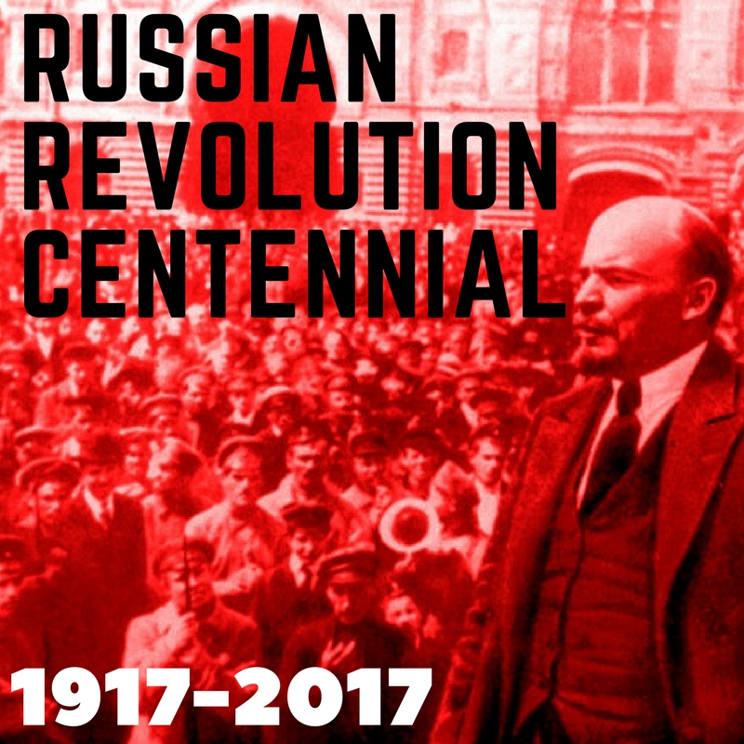
discipleship and finance Phil 4.10-20
Mikhail Borodin
‘That man Paul. He was a real revolutionary. I take my hat off to him!’
Notes:
This year, 2017, has marked the centenary of the Communist revolution in Russia. In 1917 Lenin and other Russian revolutionaries, inspired by the ideas of Karl Marx, took power through violent revolution and established a communist state.
Communism spread further, becoming established in much of eastern Europe and also making headway in the wider world in countries such as China and Cuba.
It has much to say about finance and wealth, arguing for a radical equality.
It is hugely significant movement in the history of the C20. Remains important in the C21. But it is discredited. Radical equality did not materialise. In reality, there was much suffering, much inequality and injustice. Leaders lined their own pockets at the expense of the poor. The revolution wasn’t as revolutionary as it claimed to be.
In the light of this the following quotation is significant. Mikhail Borodin, Soviet Mission Chief to Chine in the days of Lenin. In a meeting with an American journalist he said this:
‘You know…I used to read the New Testament. Again and again I read it. It is the most wonderful story ever told. That man Paul. He was a real revolutionary. I take my hat off to him!’
The apostle Paul, a real revolutionary. This is absolutely right. Whether it’s his teaching, his attitude, his example, he is truly revolutionary. Not least in his attitude to discipleship and finance, as we see from this passage.

Slide 2
discipleship not dysfunction
Paul believed in 360 degree discipleship.
‘[E]verything, absolutely everything, takes place on sacred ground. God has something to say about every aspect of our lives…
Including ‘the way we make our money and the way we spend it’
Eugene Peterson
Notes:
Paul believes in and practices whole-life discipleship. We are sometimes dysfunctional, I am sometimes dysfunctional. We compartmentalise our Christian faith. We seek to follow Jesus in our prayers, in our Bible reading, in our commitment to church, perhaps sharing with people personally, one-to-one.
But, on the other hand, we effectively hold areas of our lives back from God. Discipleship doesn’t seem to impact our home life, or maybe our work life, our thought life, or our spending habits and our giving.
Paul is very different. He is revolutionary.
So, in Ephesians 5, the gospel is applied to work and home.
So, in Colossians 3 the gospel is applied to holiness, 360-degree holiness. Personal and private for sure, but relationships too.
Here in Philippians 4, as it is in 2 Corinthians 8, the gospel is applied to finances.
There is nothing off-limits. For many in the west this is a revolutionary. We buy into the idea of a sacred / secular divide. But this is what Eugene Peterson says.
Eugene Peterson.
‘[E]verything, absolutely everything, takes place on sacred ground. God has something to say about every aspect of our lives: the way we feel and act in the privacy of our hearts and homes, the way we make our money and the way we spend it, the politics we embrace, the wars we fight. The catastrophes we endure, the people we hurt, and the people we help. Nothing is hidden from the scrutiny of God. Nothing is exempt from the rule of God.’
Are we holding something back from God?
If we don’t get this we miss out on so much. Paul expresses extraordinary joy throughout the letter to the Philippians. The words we’ve read breathe a deep, unshakable joy. ‘I rejoice greatly in the Lord’, he says in v10.
We only have that if we offer everything to God. If we live fully ‘in the Lord’. If we’re half in half out, that joy will be elusive.
God wants to take us deeper and give us greater joy. Is there something we’re holding back from God? That is dysfunctional. That is a disconnected life where the pieces don’t fit together. We should aim for integrated lives. 360-degree discipleship.

Slide 3
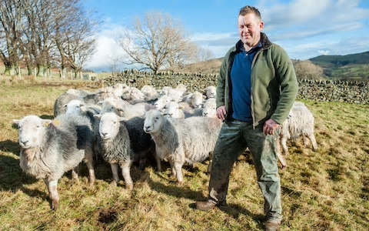
contentment not consumerism vv11-13
‘This is my life, I want no other’
James Rebanks
Notes:
2. Contentment not Consumerism
Contentment is often thought of as a revolutionary word, but it is.
Read from v11b-13.
James Rebanks, The Shepherd’s Life
Rebanks is a shepherd in Cumbria. He is an unusual shepherd. 60,000 followers on twitter. Memoir The Shepherd’s Life was no. 1 on the Sunday Times bestseller list and he has a double first in history from Oxford! He is also unusual in his contentment.
The book closes with the lines. ‘This is my life. I want no other.’
Very powerful. Few people can say that. Rebus says it lying in the grass, watching the clouds pass by, with his sheepdogs with him. It still sounds revolutionary, even though the surroundings are wonderful.
How much more Paul, in prison, having known all manner of hardships. ‘I am content…whatever the circumstances.’ Paul is not lying in the grass looking at the skies. He is in chains. Ye he too wants no other life.

Slide 4
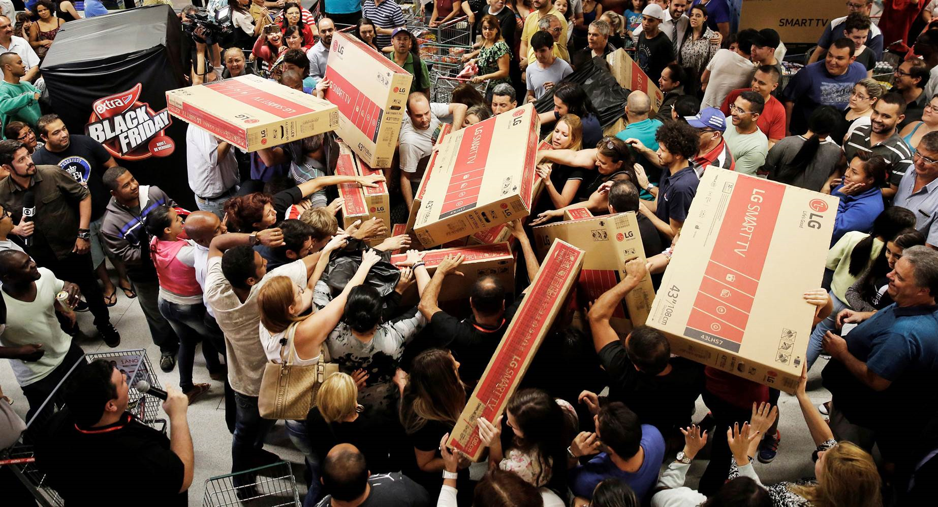
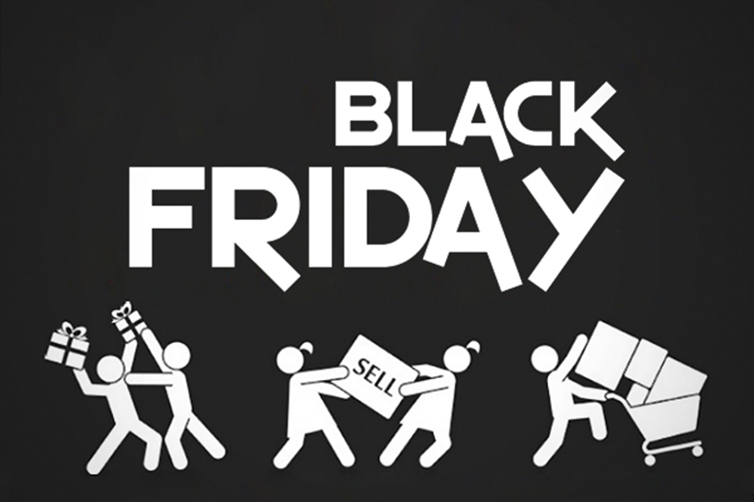
contentment not consumerism
contentment not consumerism
Notes:
Hard because of consumerism.
This relates directly to finance because the biggest challenge to being content in Christ is our consumer culture.
Black Friday. Include some statistics!

Slide 5
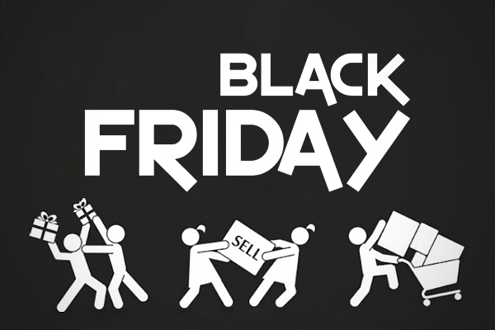
contentment not consumerism
£8 billion in four days?
Predicted 7% increase on 2016
Notes:
Consumerism has become part of the fabric of our lives. It’s very hard to stand against it. But this is our calling.
Pete Grieg
#blackfridayblues
Shopping is not a lifestyle.
Debt is dangerous for the poor.
Frenzied consumption is not OK.
Shopping malls are not leisure destinations.
Amazon is primarily and always will be the largest river in the world.

Slide 6
Practice ‘Christ sufficiency’
Tell a different story with your life.
Live creatively, simply, generously, differently
Notes:
The word that is used in v11 and 12 for contentment carries with it a sense of sufficiency; what I have is sufficient. Not self-sufficiency but sufficiency in Christ. This the secret of v12. The focus on Christ and the power of the Holy Spirit. Paul truly lives as one who is in Christ, and this is enough for him.
We really have to work at this. ‘Militant Contentment’. Pete Grieg.
Life generously
Do we need something? Really? Don’t accumulate stuff.
George Verwer. Took off his suit. A bag might be better.
Tell a different story.
Live creatively, generously, differently.
Work this out in home groups.
Disciples are content. Disciples are different. Disciples swim against the stream of rampant, unchecked consumerism.

Slide 7
giving not grasping
Part of their discipleship from the first (v15)
Prompted by the gospel (v15) and their ‘concern’ for Paul (v10)
Intentional (v16). ‘Even in Thessalonica’
Regular (v16)
Generous in relation to what they had, and
Sacrificial (cf. 2 Corinthians 8.1-4)
It was ‘credited to their account’ (v17), an ‘offering to God’ (v18)
Notes:
Go through slide

Slide 8
giving not grasping
Principles
Love for God, his gospel and for people; giving is intrinsic to discipleship; investing for the future
Practicalities
Intentional, regular, generous
and sacrificial

Slide 9
a challenge regarding giving and vision
One of the challenges we face is giving
As we seek to agree vision, values and concrete changes, the prayer is that giving will increase
But direct encouragement is also biblical

