Slide 1
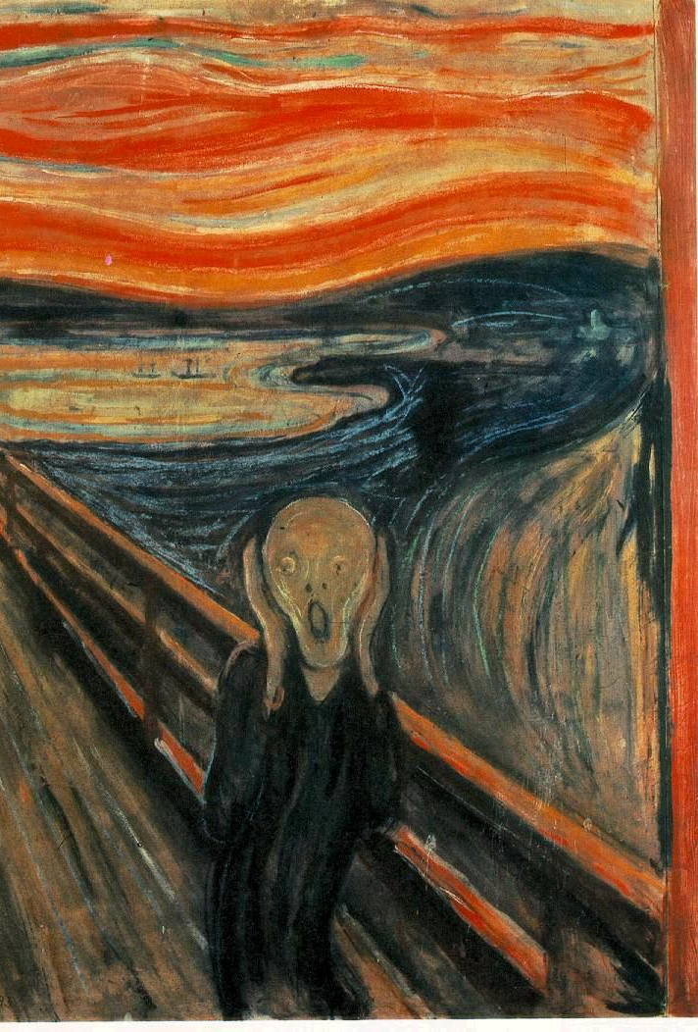
Psalm 88 discipleship in the dark

Slide 2
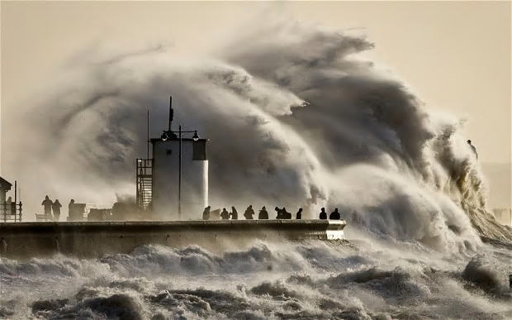
The Disciple’s Experience
a. the Psalmist seems near death
His life ‘draws near to the grave’ (v3).
From his ‘youth’ he has been ‘afflicted and close to death (v15).
He is like a drowning man (vv7, 16-17).
Notes:
The Disciple’s Experience
a. the Psalmist seems near death
His life ‘draws near to the grave’ (v3).
From his ‘youth’ he has been ‘afflicted and close to death (v15).
He is like a drowning man (vv7, 16-17).

Slide 3
b. the Psalmist is desperately lonely
The Psalmist appears to have been abandoned by his ‘closest friends’ and ‘companions’ (vv8, 18). He is ‘repulsive’ to those to whom he looked for comfort and support (v8).
Notes:
b. the Psalmist is desperately lonely
The Psalmist appears to have been abandoned by his ‘closest friends’ and ‘companions’ (vv8, 18). He is ‘repulsive’ to those to whom he looked for comfort and support (v8).

Slide 4
c. the Psalmist believes they are under God’s wrath
‘Why, O Lord, do you reject me and hide your face from me (v14)?’
The Psalmist believes he is under the ‘wrath of God’ (vv7, 16
Is it really true that this man, a believer in God, a disciple, is being ‘relentlessly pounded by [God’s] waves of anger

Slide 5
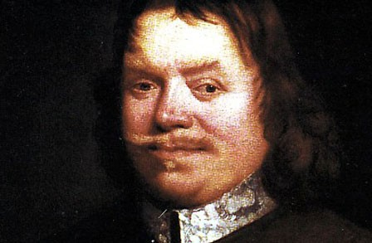
The Disciple’s Response
a. Keep Perspective
The example of
John Bunyan

Slide 6
b. Keep trusting
God remains sovereign over his situation. Repeatedly he articulates this deeply held belief (e.g. vv 7-9; 18).
And this sovereign God is also loving.
Notes:
b. Keep trusting
God remains sovereign over his situation. Repeatedly he articulates this deeply held belief (e.g. vv 7-9; 18).
And this sovereign God is also loving.

Slide 7
b. Keep Praying
The faithful disciple keeps coming to him in prayer (vv1, 9).
Honest Prayer
Prayer when words fail
Notes:
b. Keep Praying
The faithful disciple keeps coming to him in prayer (vv1, 9).
Honest Prayer
Prayer when words fail

Slide 8
c. Keep hoping
The Psalm in context
Psalms of deliverance
The Grace of God in Jesus
Notes:
c. Keep hoping
The Psalm in context
Psalms of deliverance
The Grace of God in Jesus

