Slide 1
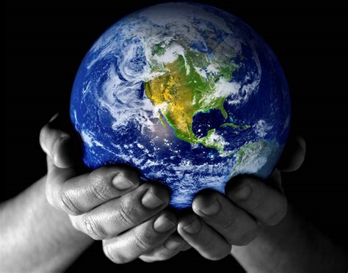
Acts: ‘The Church that Changed the World’
Acts 1.1-11
The Message and the Messengers

Slide 2
1. The Message
Jesus’ teaching (v1)
Jesus’ suffering and death (v3)
His resurrection (v3)
His ascension (vv2, 9)
The sending of the Spirit (v5)
Jesus’ visible personal return (v11)
He is the once, present and future King (v3)

Slide 3
But is it true?
We can sometimes doubt it.
She said: “one can't believe impossible things.” “I daresay you haven't had much practice,” said the Queen. “When I was your age, I always did it for half-an-hour a day. Why, sometimes I've believed as many as six impossible things before breakfast.

Slide 4
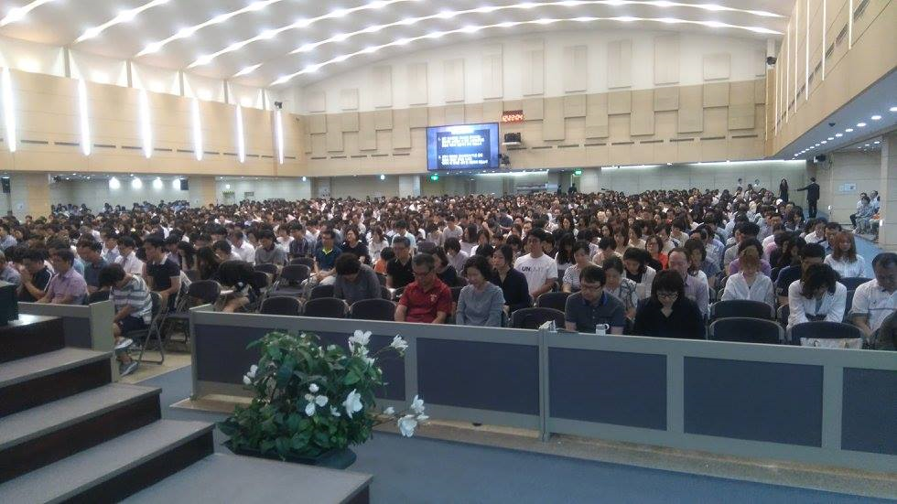
Sometimes we can doubt. When we don’t see much evidence of gospel progress, and when we struggle with issues such as unanswered prayer.

Slide 5
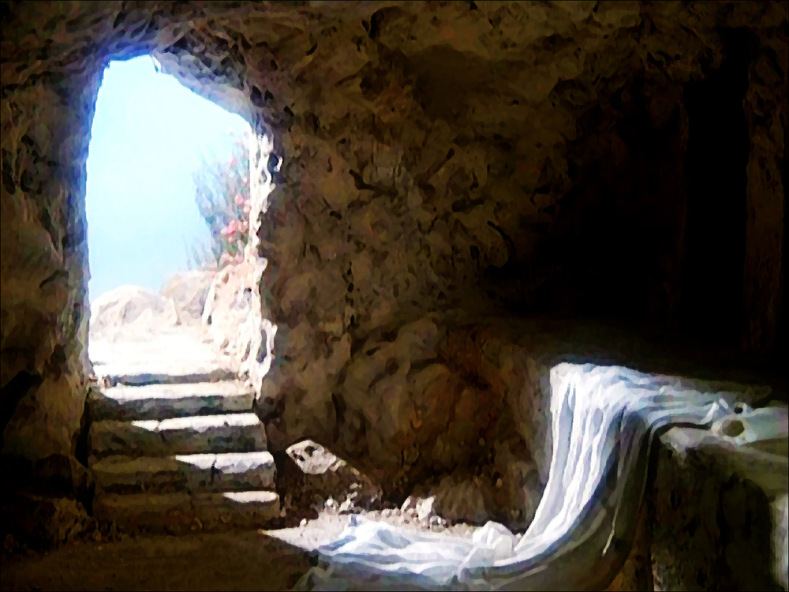
Luke writes to give us a firm foundation
v3 ‘convincing proofs…’

Slide 6
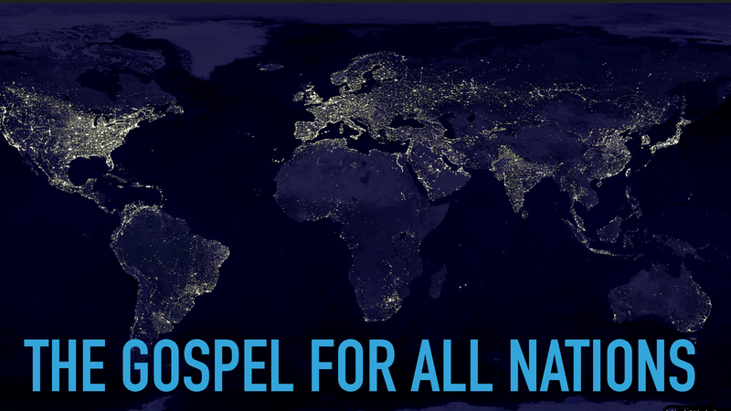
3. The Messengers
Vv6-8
The Message of the Kingdom
Not a kingdom with borders and not fully established immediately
But the gospel for the whole world

Slide 7
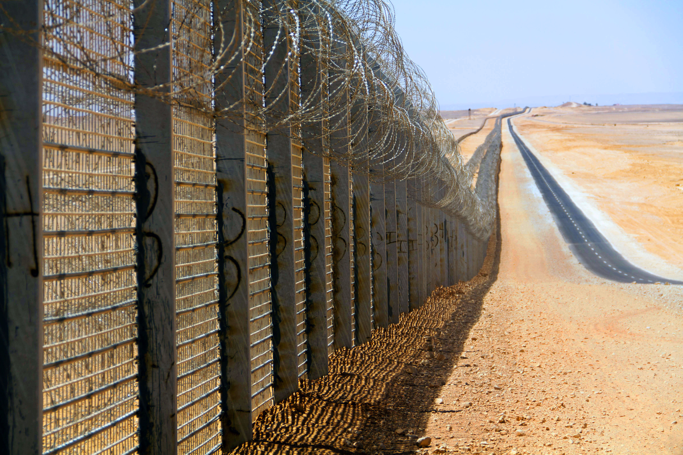
Called to be witnesses across boundaries (v8)

Slide 8
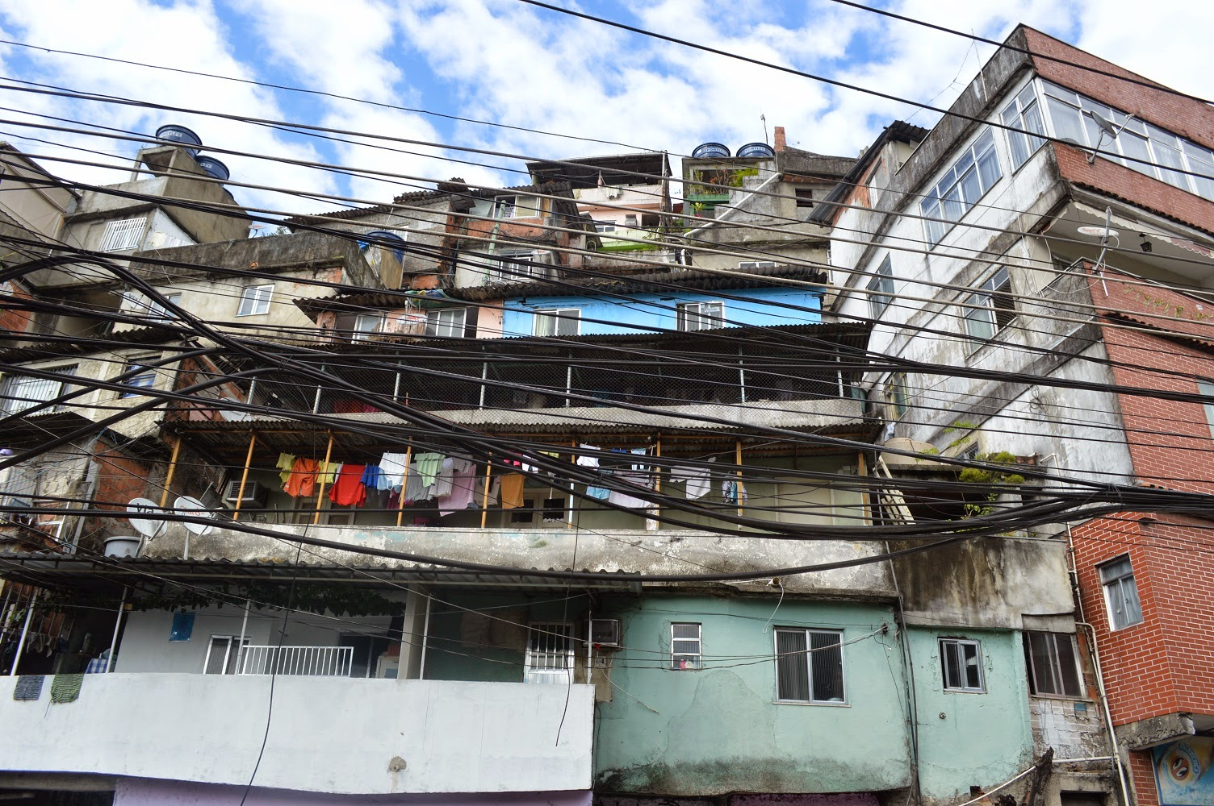
Empowered by the Spirit (v8)

