Slide 2
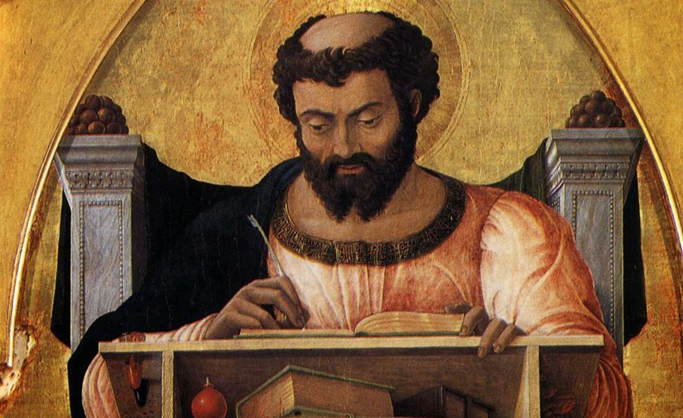
Which is your favourite Gospel?
Why do you think we have 4 Gospels?
How is Luke different from the other 3?
What are some of the key themes in Luke?

Slide 3
Key Theme
Greek words for Saviour, salvation
8 x in Luke, 9 x in Acts, nowhere in Matthew & Mark
Jesus’ desire to seek and save outcasts

Slide 4
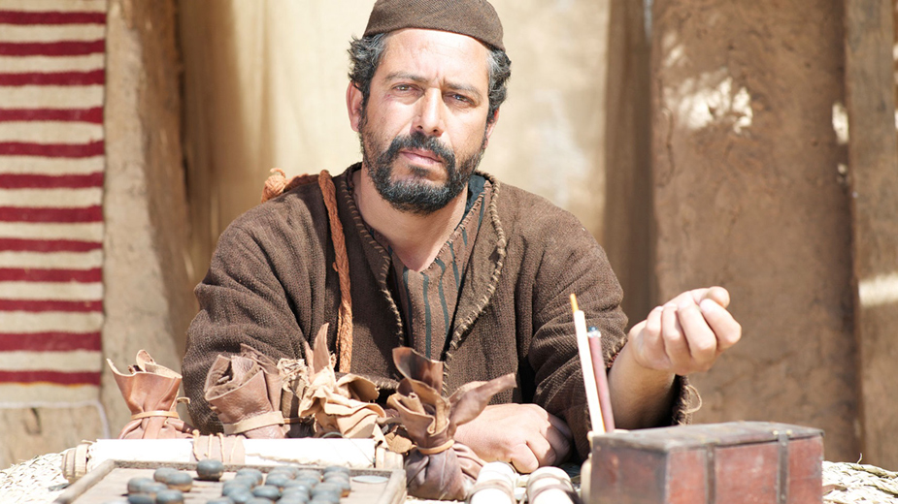
The calling of Levi: Luke 5:27-32

Slide 5
The calling of Levi: Luke 5:27-32
Jesus’ invitation (27-28)
Levi’s banquet (29)
Pharisees’ objections (30)
Jesus’ response (31-32)

